Slide 1
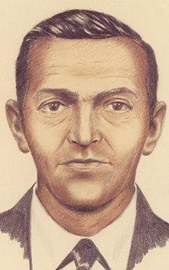
FACIAL COMPOSITE
Tomer Erez
Gal Mishan
Shahar Dvir
Tal Sadot

Slide 2
PROJECT DEFINITION - FACIAL COMPOSITE BUILDER FROM TEXT
The purpose of the project is to create sketches of faces according to textual descriptions

Slide 3
DATA EXPLORATION - CELEBA
The data contains:
202,599 number of face images of various celebrities
10,177 unique identities, but names of identities are not given
40 binary attribute annotations per image
5 landmark bounding boxes

Slide 4
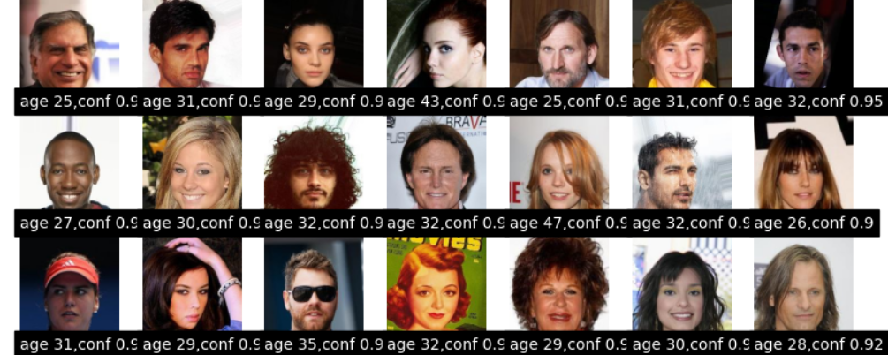
PART 1 – DATA ENRICHMENT
Adding age to the data frame based on age predictor NLP.
Convert the binary vector into a sentence.

Slide 5
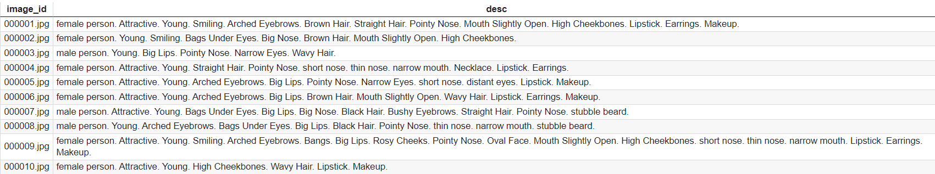
PART 2 – DATA PREPROCESSING
PREPARE THE TEXT DATA FOR THE TRAINING OF THE MODEL.

Slide 6
FINE TUNING
Fine tuning for Diffusion model – colab

Slide 7
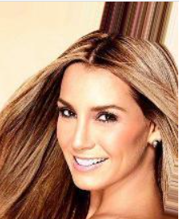
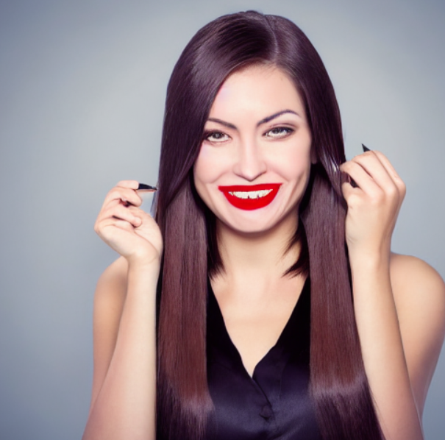
MODEL VS REAL PICTURE
female person. Attractive. Young. Smiling. Arched Eyebrows. Brown Hair. Straight Hair. Pointy Nose. Mouth Slightly Open. High Cheekbones. Lipstick. Earrings. Makeup.

Slide 8
EVALUATION
Compare the face images that was created by the models and check if the fine tuning is working.
There are many different approaches to evaluate accuracy of an image.

Slide 9
DALLE
Use prompt as Dalle to compare our model with LLM.

Slide 10
PRODUCT
GUI which the user can put a description of a person and get a facial composite.

